Slide 1


Jeff Brown
Introduce yourself and your company/idea. Use logos, symbols, etc.

Slide 2
10
20
30
Slides
Minutes
Point Type

Slide 3
Less words the better!

Slide 4
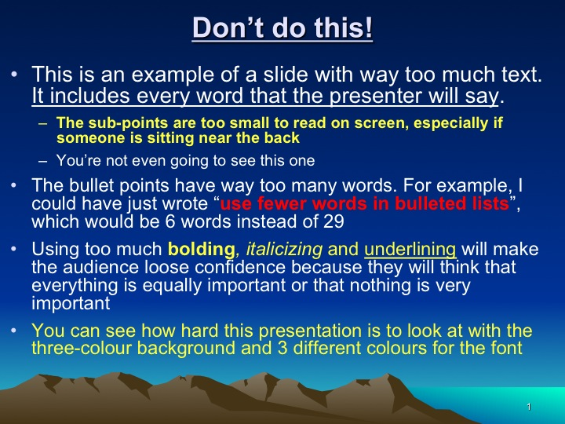
Don’t do this!

Slide 5
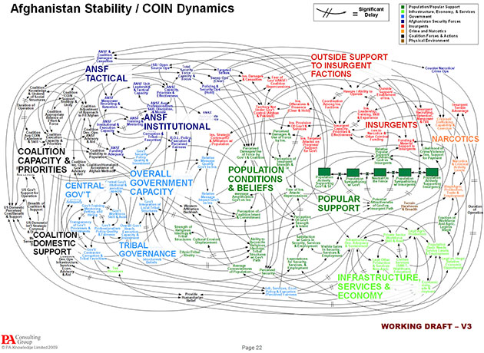
Or This!

Slide 6
Face the audience!

Slide 7
Don’t read the slides, tell a story!

Slide 8
Jeff J. Brown
Introduce yourself and your company/idea. Use logos, symbols, etc.

Slide 9

Problem
Tell the problem you are solving and for whom. Make it a story the audience can easily see the problem that needs to be solved.

Slide 10
Big concept solution.
Bring the attention of your audience to a key concept using icons or illustrations

Slide 11
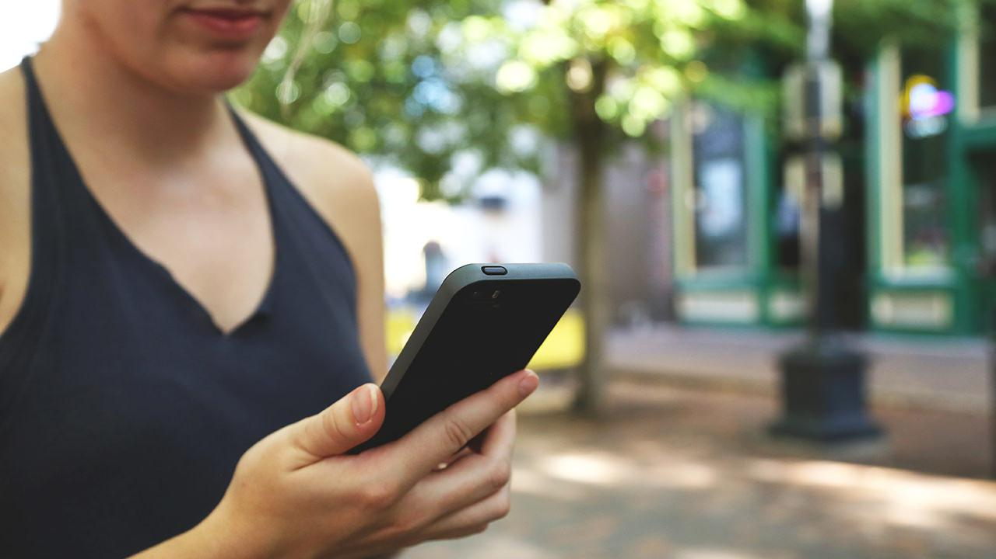
A few details on how the solution works
Here you have a list of items
And some text
But remember not to overload your slides with content
Your audience will listen to you or read the content, but won’t do both. Maybe a demo.

Slide 12

A picture is worth a thousand words
A complex idea can be conveyed with just a single still image, namely making it possible to absorb large amounts of data quickly.

Slide 13

Want big impact?
Use big image.

Slide 14

Use charts to explain your ideas
Yellow
Blue
Red

Slide 15

Tables to compare data
 | A | B | C
Yellow | 10 | 20 | 7
Blue | 30 | 15 | 10
Orange | 5 | 24 | 16

Slide 16

89,526,124
Whoa! That’s a big number, aren’t you proud?

Slide 17
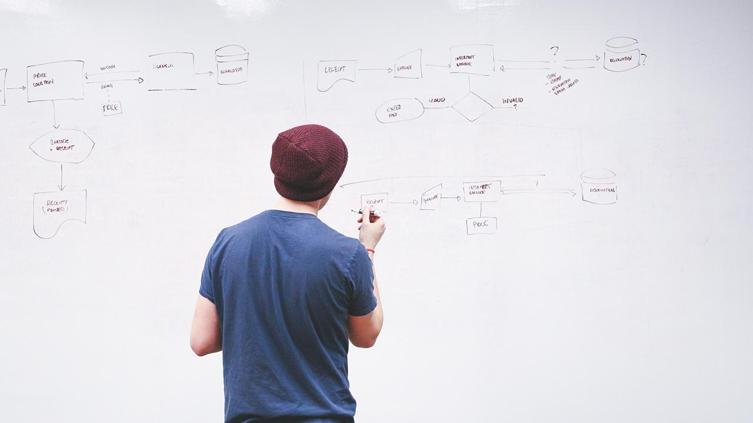
Our process:
first
second
last

Slide 18

Android project
Place your screenshot here
Show and explain your web, app or software projects using these gadget templates.

Slide 19
iPhone project
Place your screenshot here
Show and explain your web, app or software projects using these gadget templates.

Slide 20
Tablet project
Place your screenshot here
Show and explain your web, app or software projects using these gadget templates.

Slide 21
Desktop project
Place your screenshot here
Show and explain your web, app or software projects using these gadget templates.

Slide 22
The Team:
Mike Aimes
Xavier Brown
Thiago Rezende
Jeff Brown

Slide 23
Thanks!
Any questions?
Find me at @username & user@mail.me
Team name and logo again! End with: Thank you we are team ………

Slide 24
Slide 1: Introduction Slide with Vision and value proposition
Slide 2: The problem
Slide 3 & 4: The solution (Not technical. Tell how it solves the problem.)
Slide 5 & 6: Market & Financials

Slide 25
Slide 7: Team (Show that your team can do this.)
Slide 8: Thank you and questions
Other possibilities:
Partnerships
Demo and screenshots

Slide 26
Presentation design
This presentation uses the following typographies and colors:
Titles: Merriweather
Body copy: Open sans
You can download the fonts on these pages for free:
https://www.fontsquirrel.com/fonts/merriweather
https://www.fontsquirrel.com/fonts/open-sans
Yolk Yellow #ffa800
Navy Blue #294667
You don’t need to keep this slide in your presentation. It’s only here to serve you as a design guide if you need to create new slides or download the fonts to edit the presentation in PowerPoint®

Slide 27
SlidesCarnival icons are editable shapes.
This means that you can:
Resize them without losing quality.
Change line color, width and style.
Isn’t that nice? :)
Examples:

Slide 28
😉
Now you can use any emoji as an icon!
And of course it resizes without losing quality and you can change the color.
How? Follow Google instructions https://twitter.com/googledocs/status/730087240156643328
✋👆👉👍👤👦👧👨👩👪💃🏃💑❤😂😉😋😒😭👶😸🐟🍒🍔💣📌📖🔨🎃🎈🎨🏈🏰🌏🔌🔑 and many more...

